Slide 1
Self-introduction
112級 統計系 李宗祐
English name : Kevin

Slide 2
5 topics
Background
Family
Schedule
Hobby
Dream

Slide 3
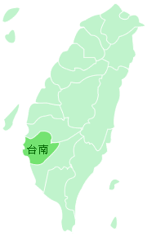
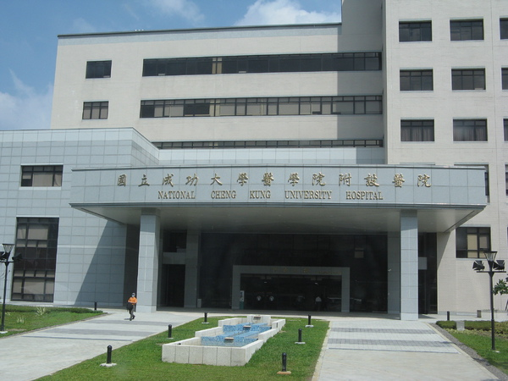
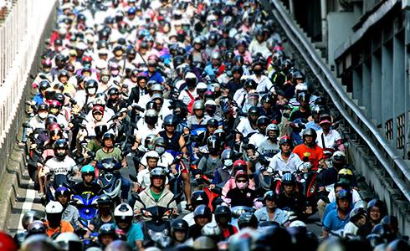
Background

Slide 4
5 topics
Background
Family
Schedule
Hobby
Dream

Slide 5
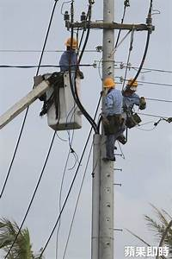


Family

Slide 6
5 topics
Background
Family
Schedule
Hobby
Dream

Slide 7
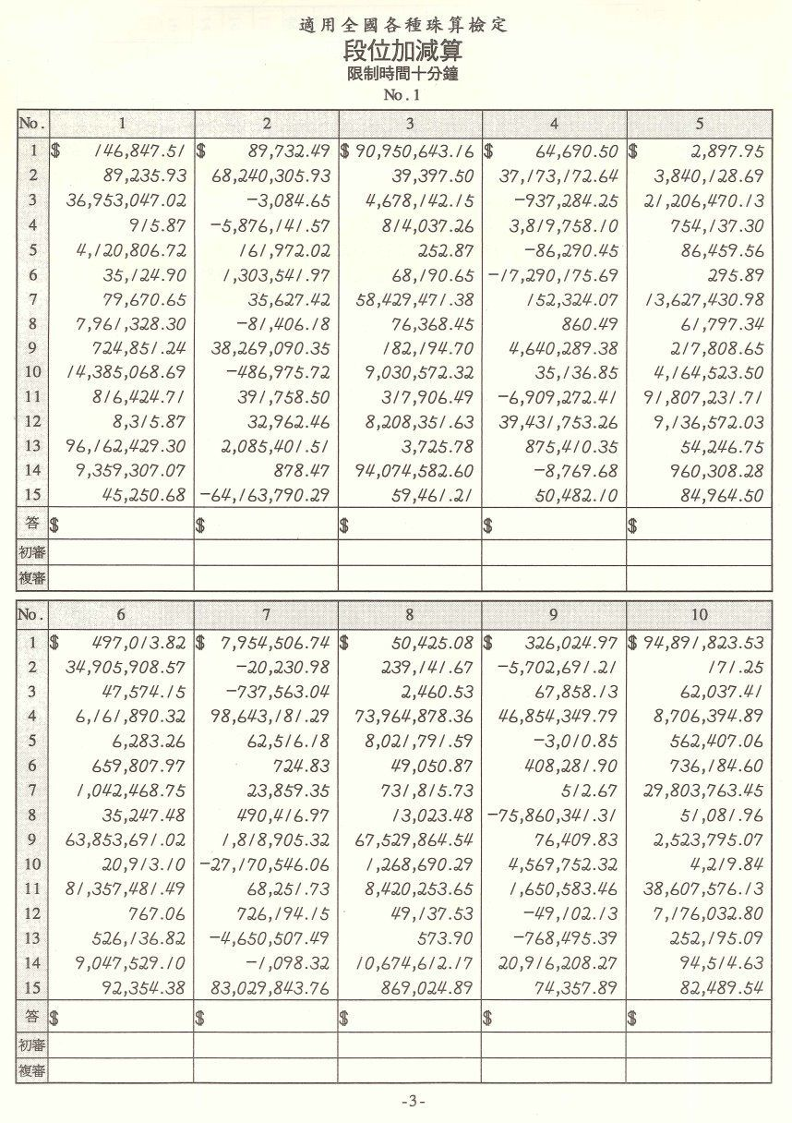

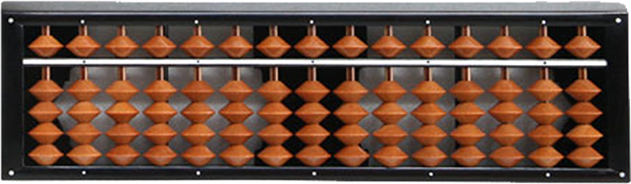
Schedule
Mental arithmetic 心算
Abacus 算盤

Slide 8
5 topics
Background
Family
Schedule
Hobby
Dream

Slide 9
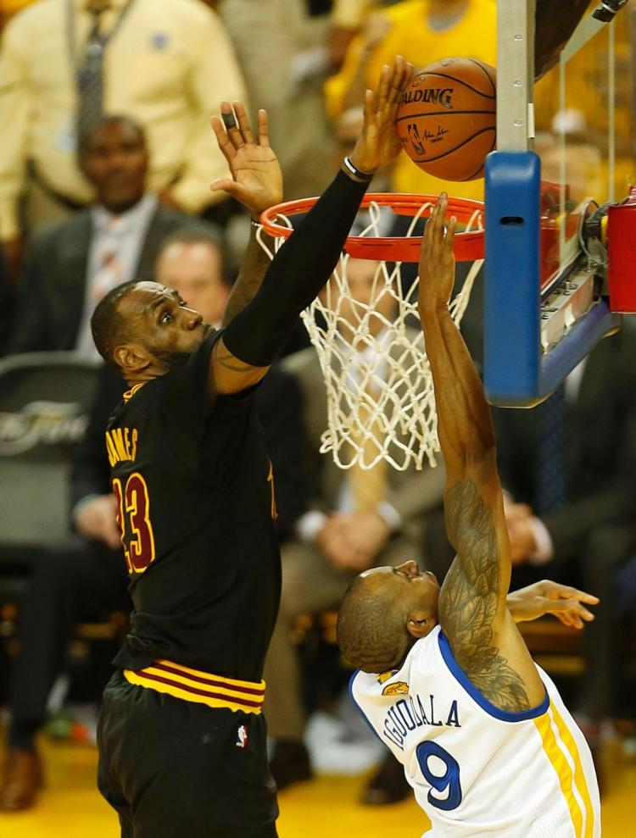

Hobby

Slide 10
5 topics
Background
Family
Schedule
Hobby
Dream

Slide 11
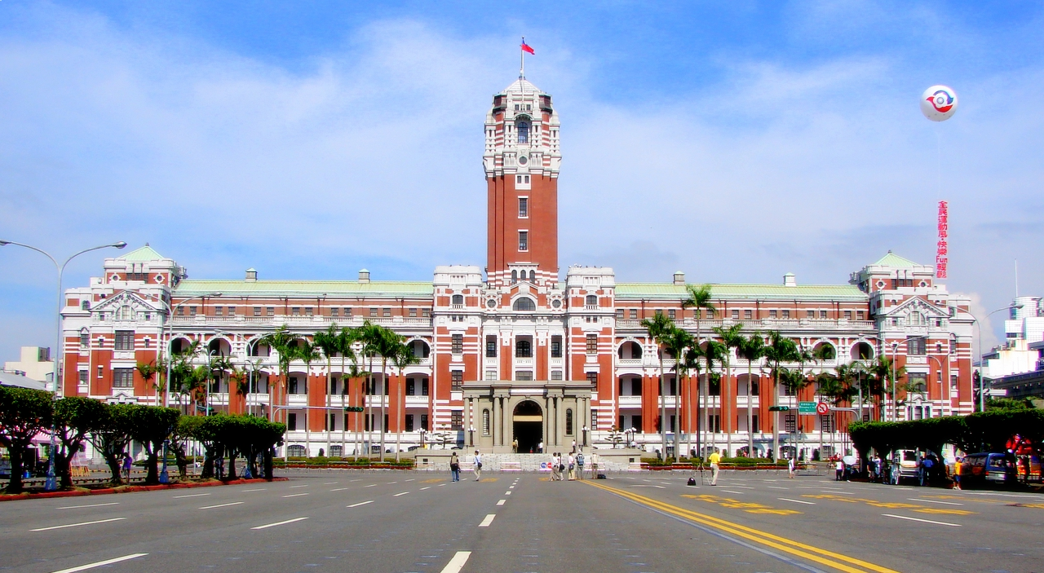

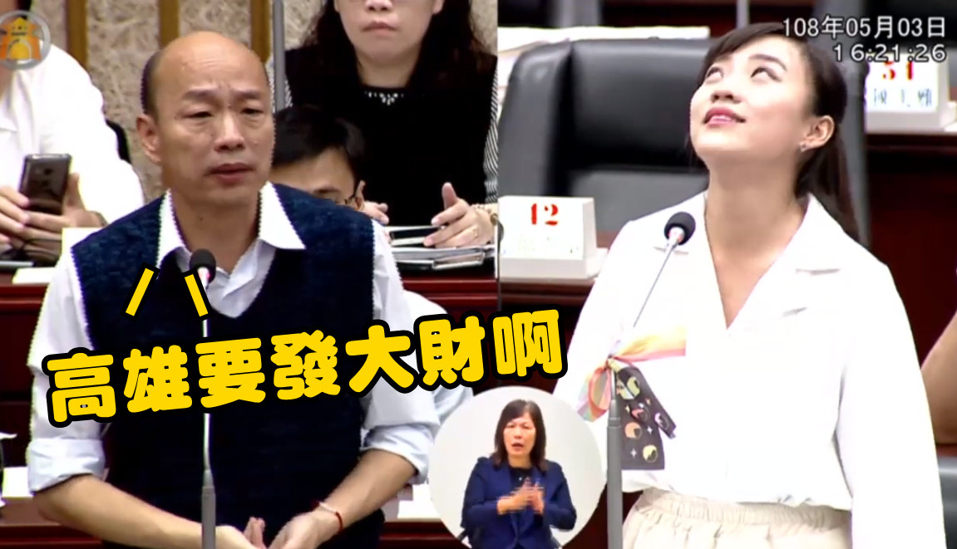
Dream

Slide 12
Background
Family
Schedule
Hobby
Dream

Slide 13
Q and A

